Slide 1
Football
Generated by VisionDeck

Slide 2

Football, also known as soccer in some parts of the world, is one of the most popular sports on the planet.
With billions of fans worldwide, football is a game of skill, strategy, and passion.

Slide 3
The origins of football can be traced back centuries, with various forms of the game played across the globe.
The modern game of football, as we know it today, evolved in England during the 19th century.
The first international football match was played between England and Scotland in 1872.

Slide 4
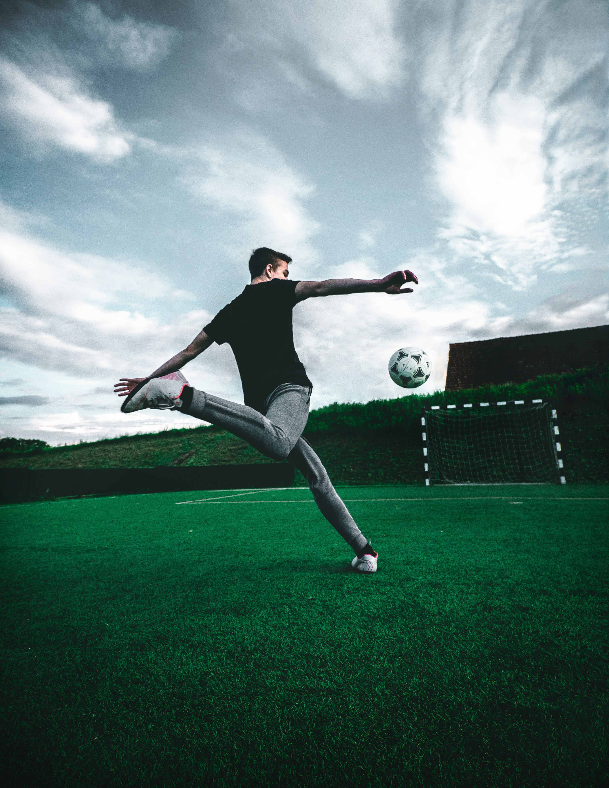
The FIFA World Cup is the most prestigious international football tournament in the world.
Held every four years, the World Cup brings together the best national teams from around the globe.

Slide 5
Football has produced some of the greatest athletes in history.
From Pelé to Messi, Maradona to Ronaldo, iconic players have captivated fans with their extraordinary skills.
Likewise, legendary teams like Real Madrid, Barcelona, and Manchester United have dominated the sport for decades.

Slide 6
Football continues to evolve, with new technologies and advancements influencing the game.
The use of VAR (Video Assistant Referee) has brought about significant changes in officiating.
With the growing popularity of the sport, football is poised for continued growth and innovation.

